Slide 1


Classification of Myocardial Infarction
Mentor – Mr. Parth
Team –
Akshay K S Chetangouda Patil Karan R Kishore Kumar H B
26-08-2021

Slide 2
Business Objective
Myocardial Infarction(Commonly known as “Heart attack”) is one of the most challenging problems of modern medicine. Acute myocardial infarction is associated with high mortality in the first year after it. The incidence of MI remains high in all countries. This is especially true for the urban population of highly developed countries, which are exposed to chronic stress factors, irregular and not always balanced nutrition.

Slide 3
Architecture - Flow
Data Set Details
EDA
Model Building
Model Evaluation
Deployment
Output
Challenges Faced

Slide 4
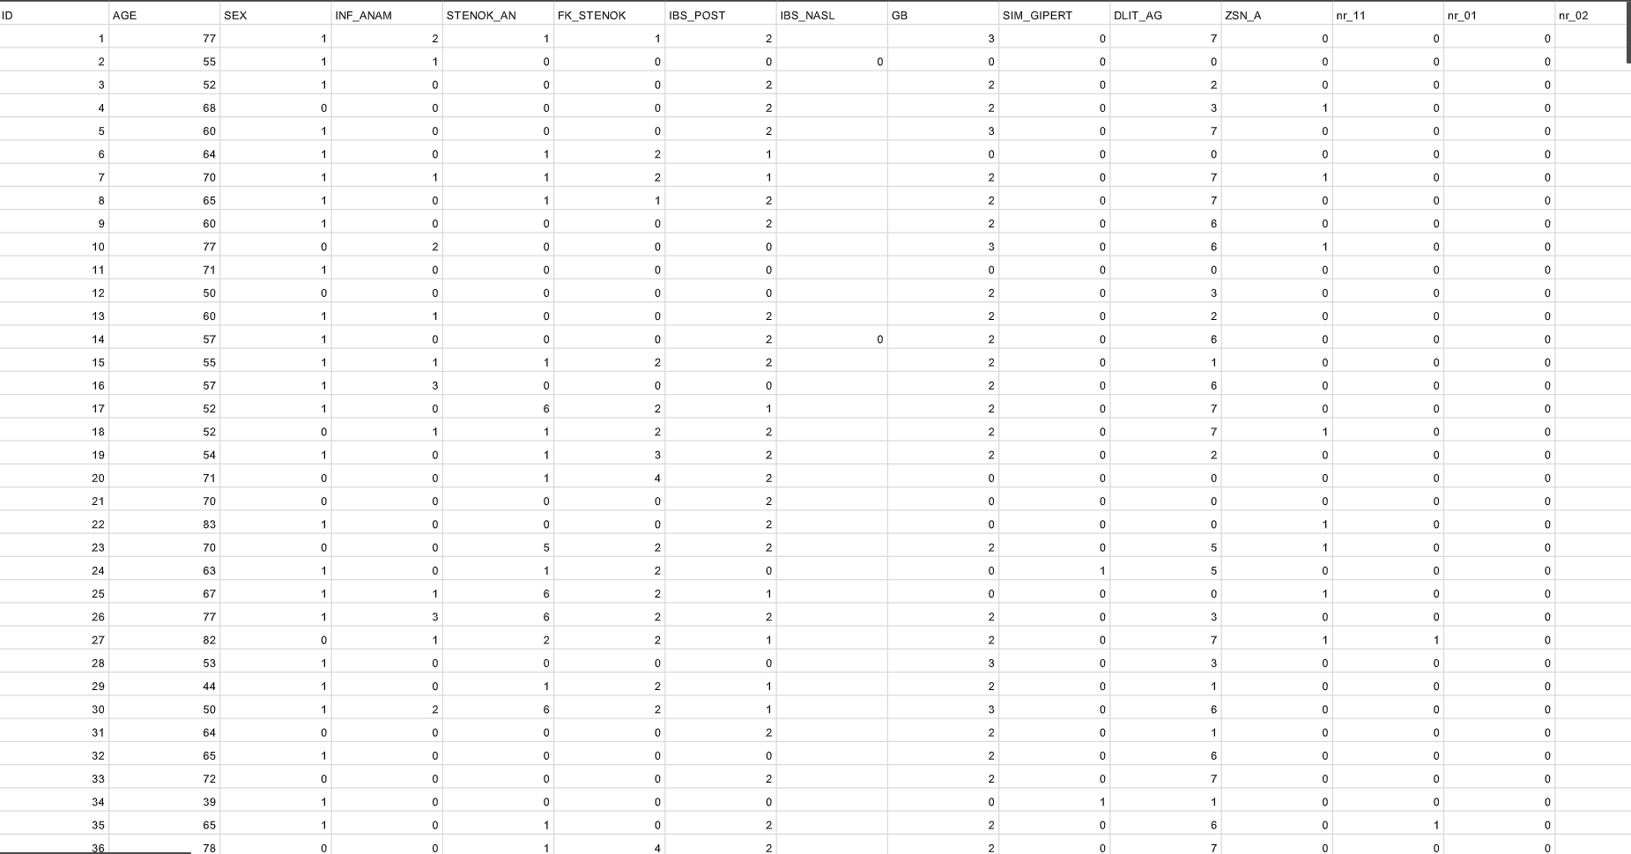
Data Set Details
No of Rows – 1701
No of Columns - 124

Slide 5
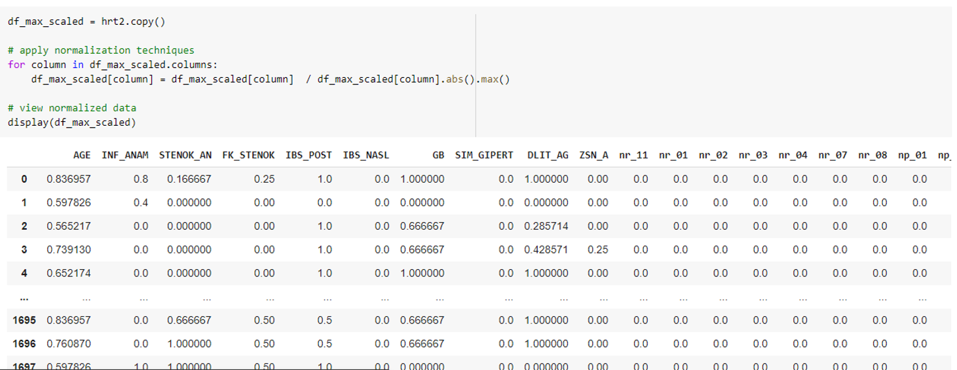
E.D.A
Normalization:

Slide 6
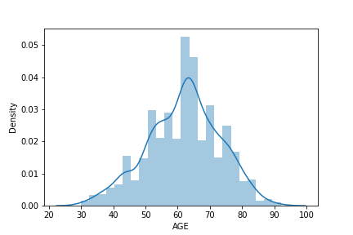
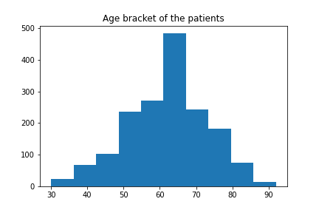
E.D.A
Some Visualizations :

Slide 7
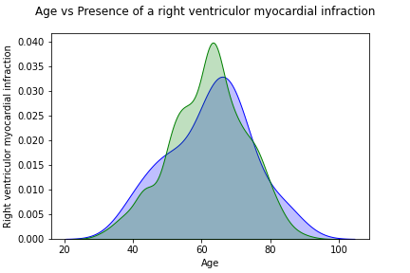
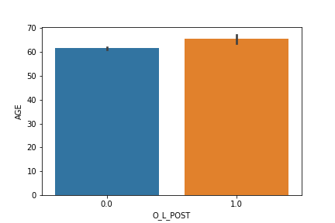
E.D.A

Slide 8
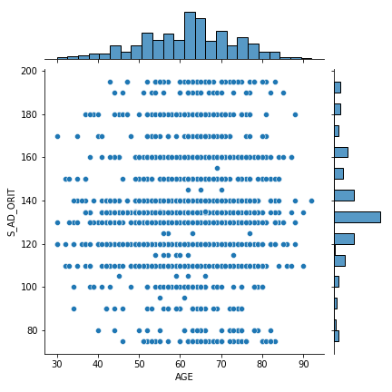
E.D.A

Slide 9
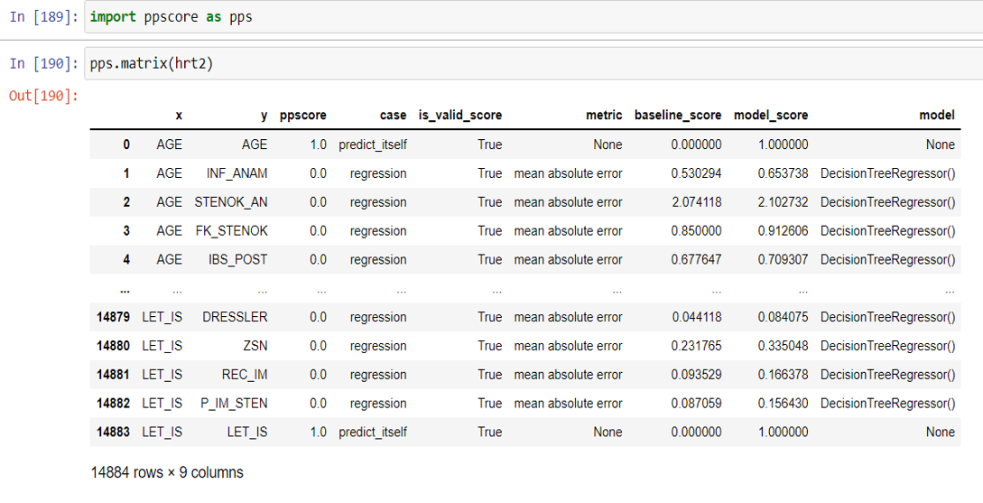
E.D.A
PPS:

Slide 10
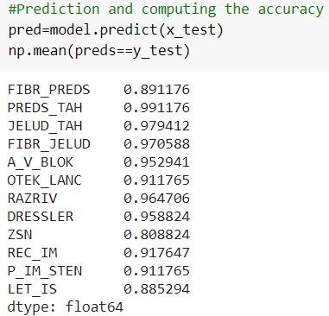
Model Building
Decision Tree Classifier using Gini Criteria:

Slide 11
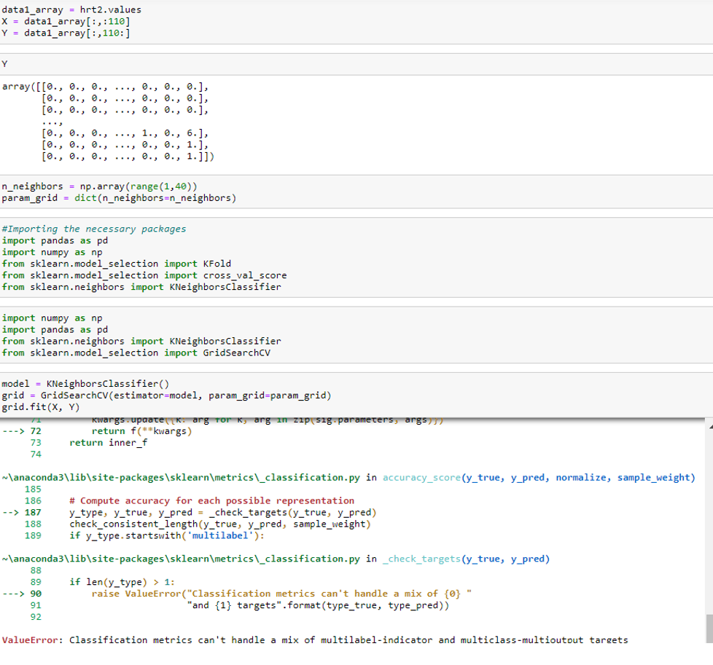
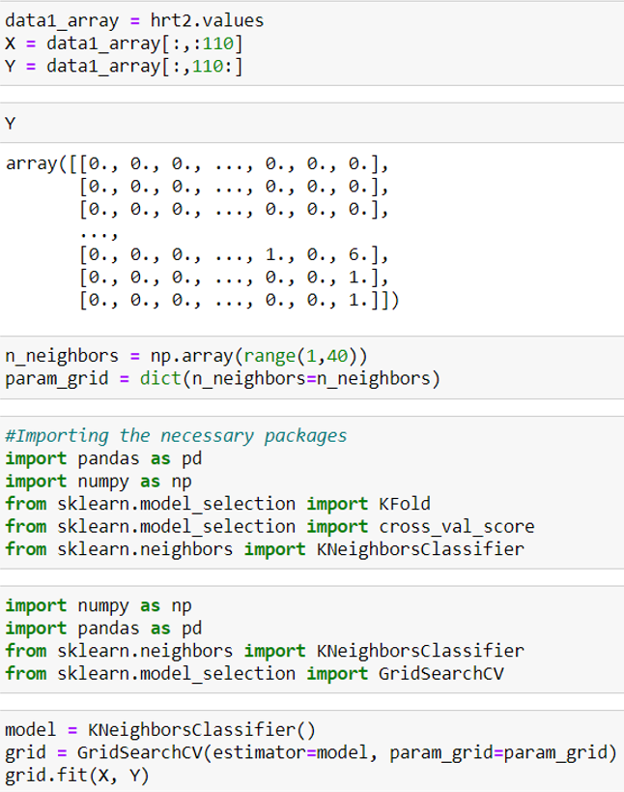
Model Building
KNN:

Slide 12
THANK YOU

Slide 13
E.D.A AND F.E
#1 Punctuation Removal
#2 Lowercased
#3 De-Emoji-ed
#4 Stop-words Removal
#5 High Frequency words removed
#6 Stemming
#7 Lemmatization

Slide 14
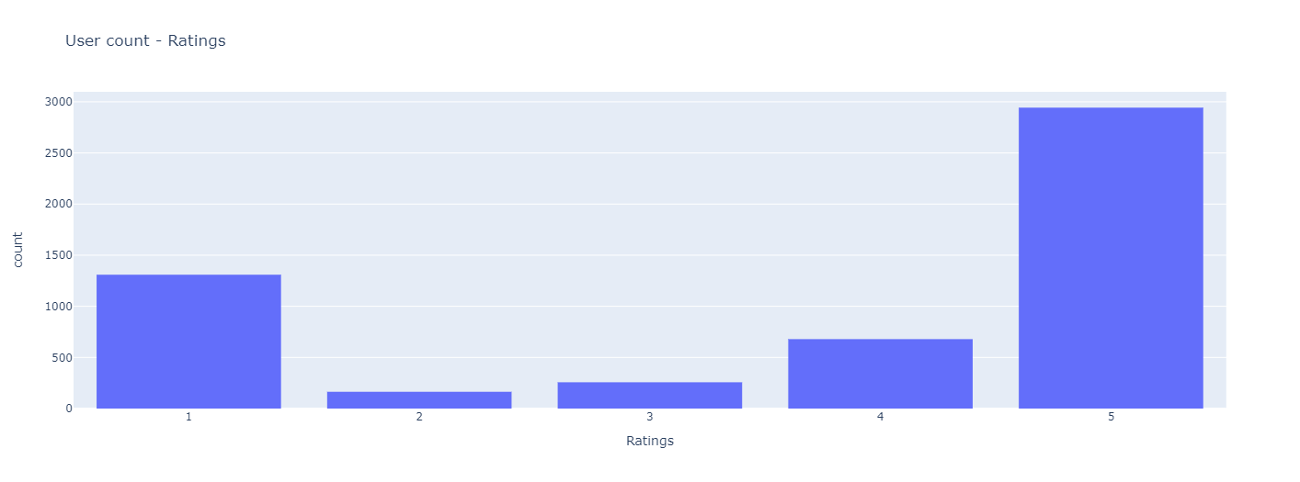
E.D.A AND F.E

Slide 16
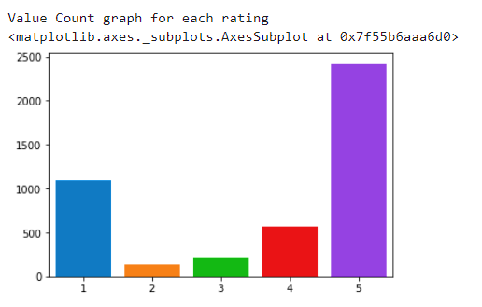
E.D.A AND F.E

Slide 17
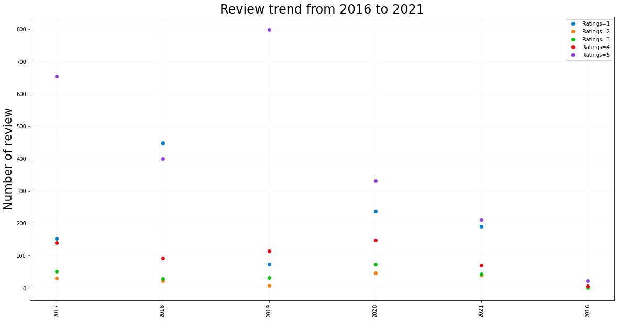

Slide 18
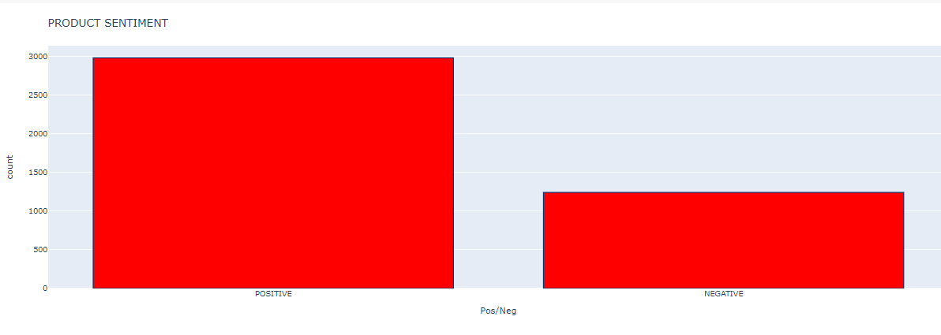
SENTIMENT ANALYSIS
CLASSIFYING the DATA-FRAME as POSITIVE and NEGATIVES, based on RATINGS

Slide 19
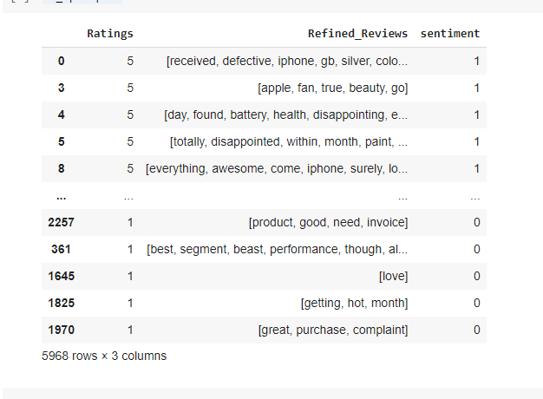
BRIDGING S.A AND M.B
#1 Balanced the Data-Frame
#2 Train Test Split – Input variable and Target variable
#3 Punction Removal – check

Slide 20
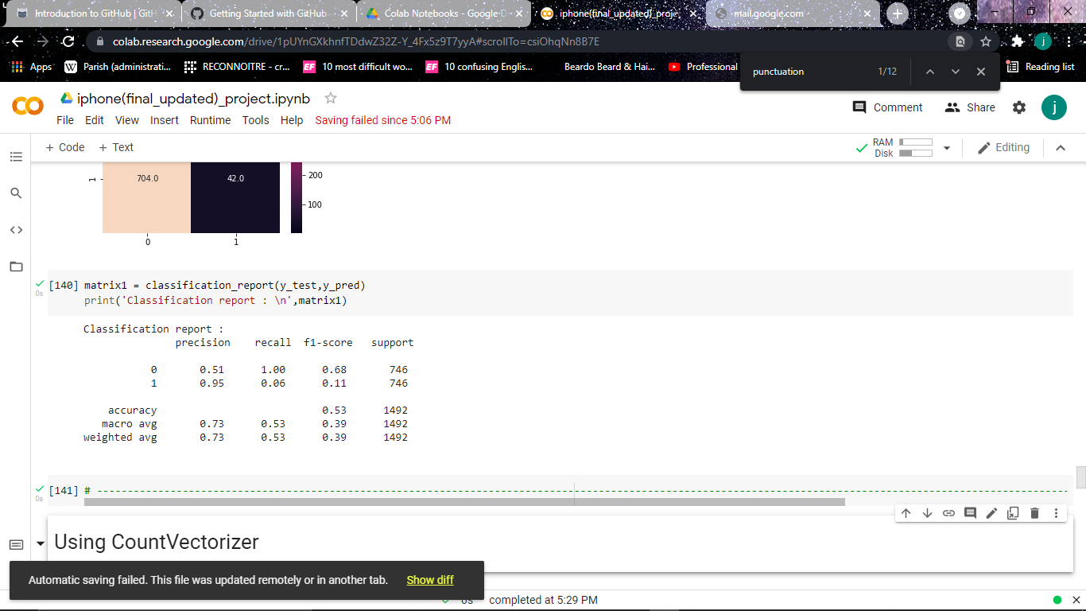
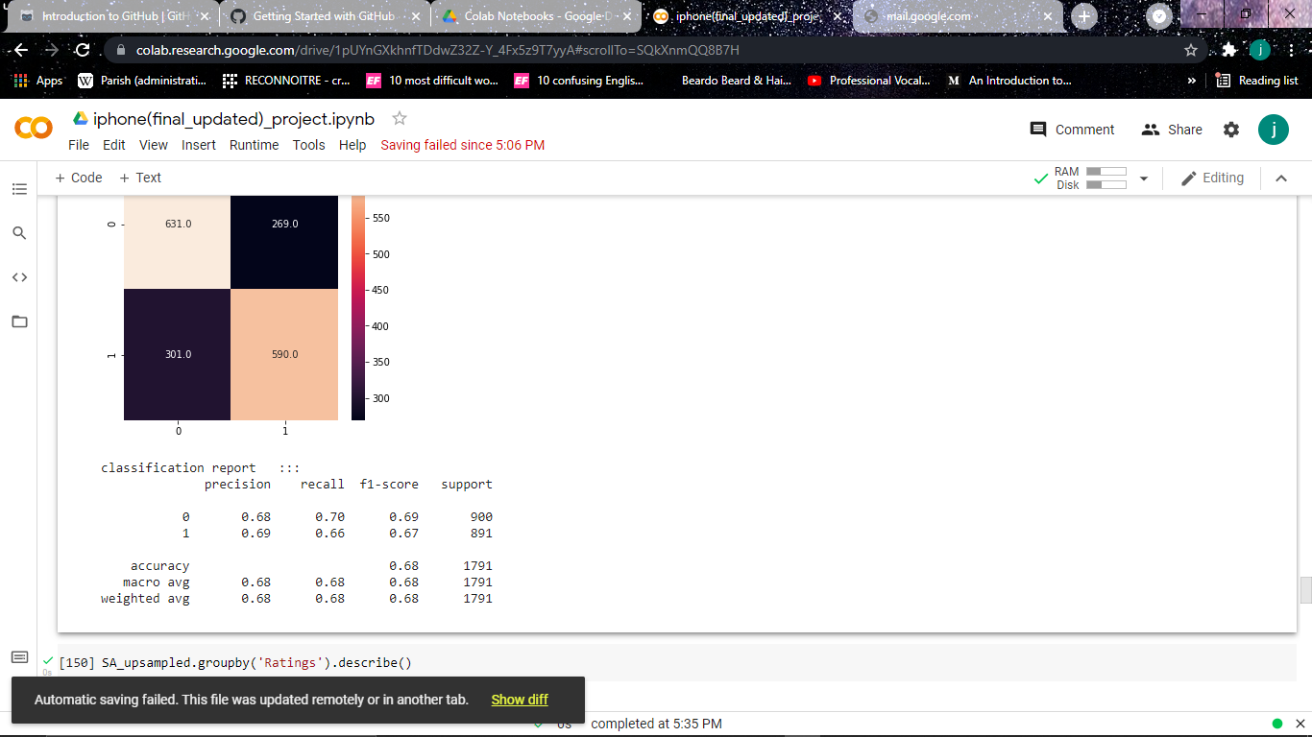
MODEL BUILDING… V-COUNT
Gaussian Naïve Bayes Multinomial Naïve Bayes

Slide 21
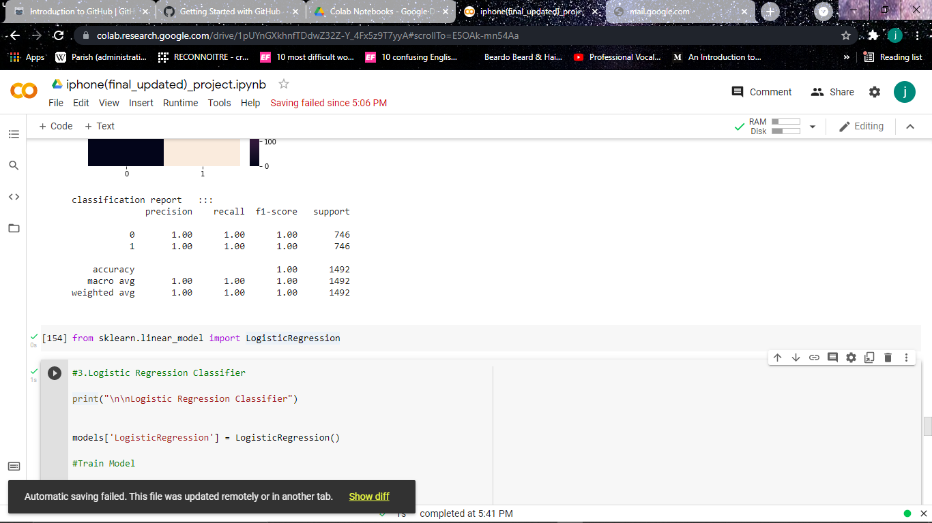
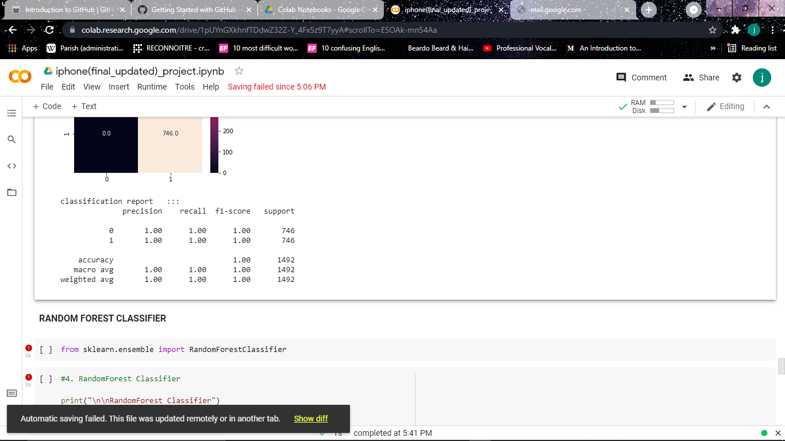
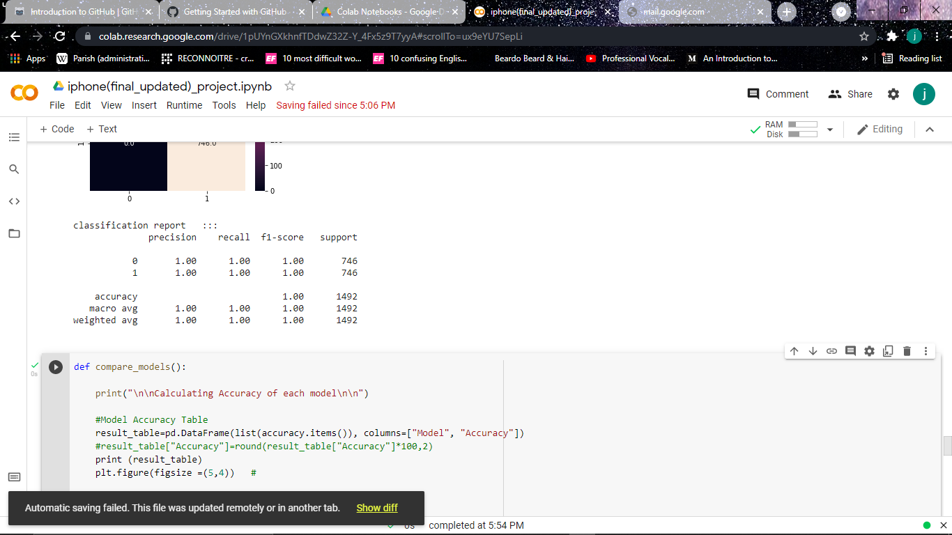
MODEL BUILDING… V-COUNT
S V M
L R C
R
A
N
D
O
M
F
O
R
E
S
T

Slide 22
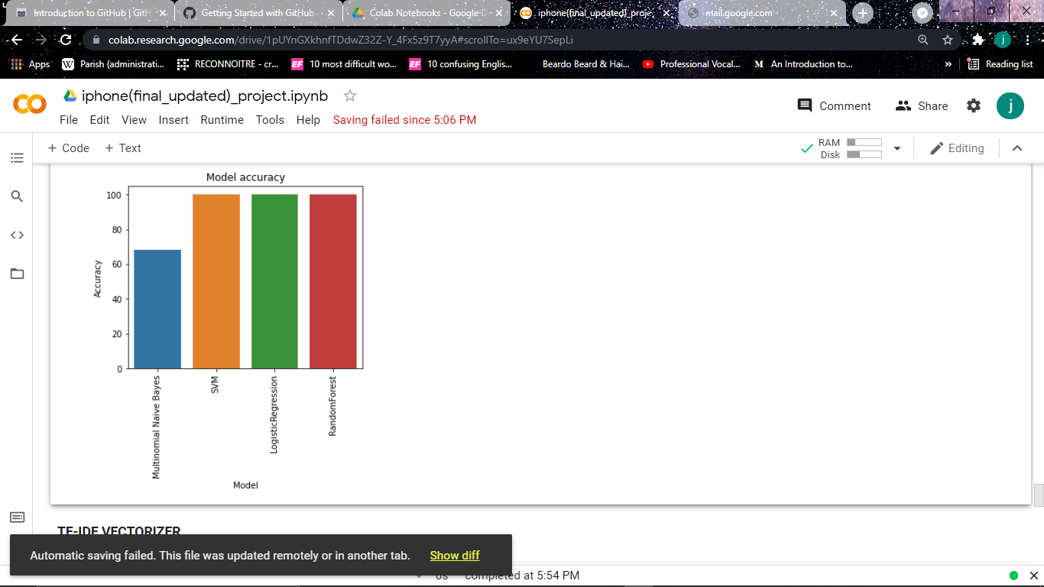
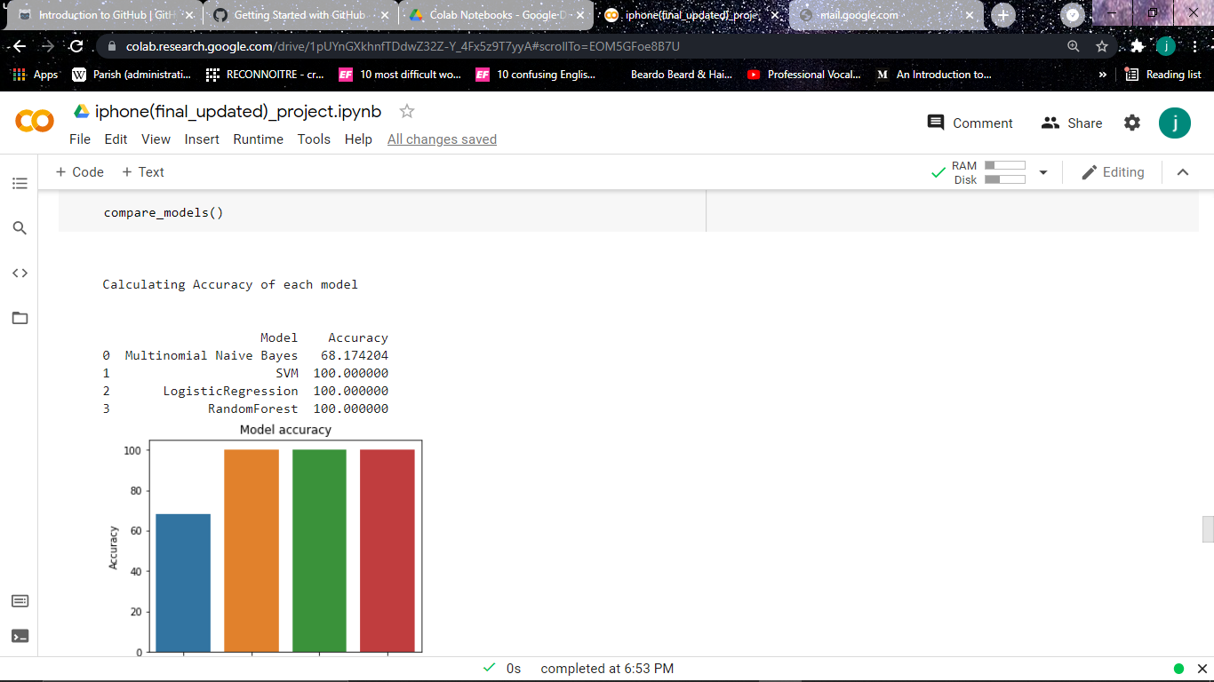
MODEL COMPARISON
V – COUNT

Slide 23
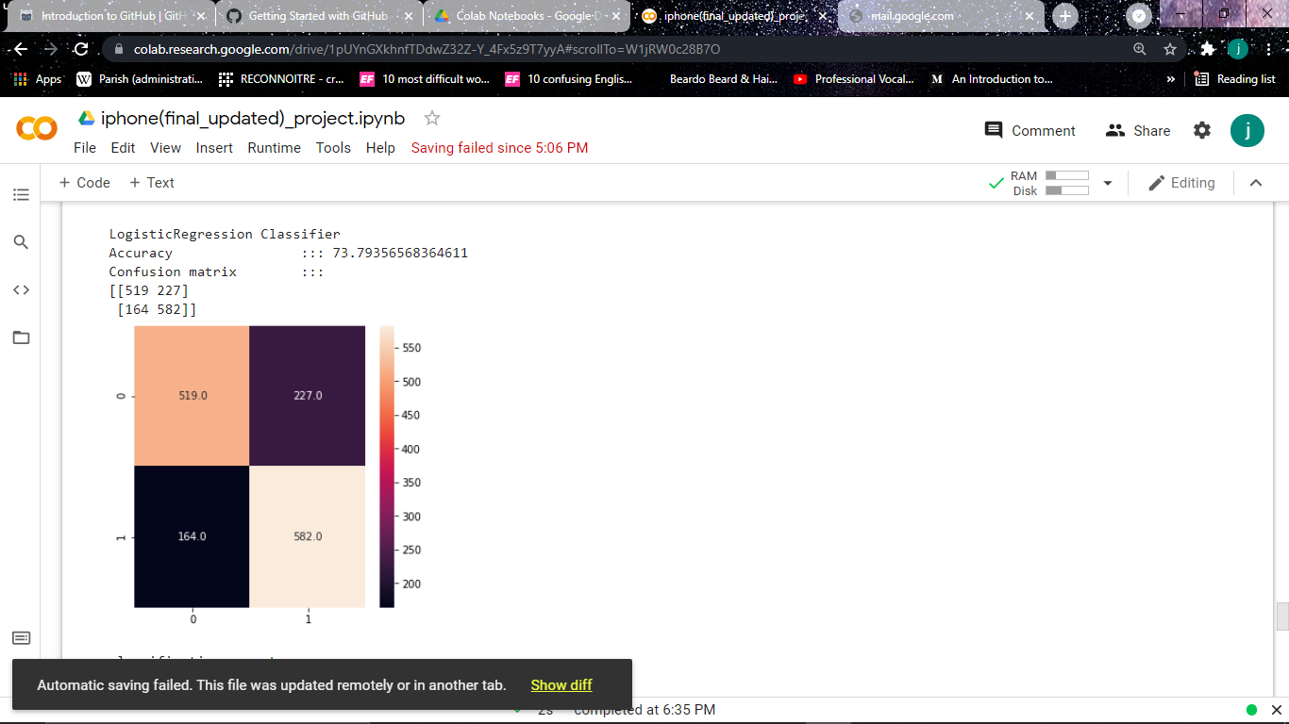
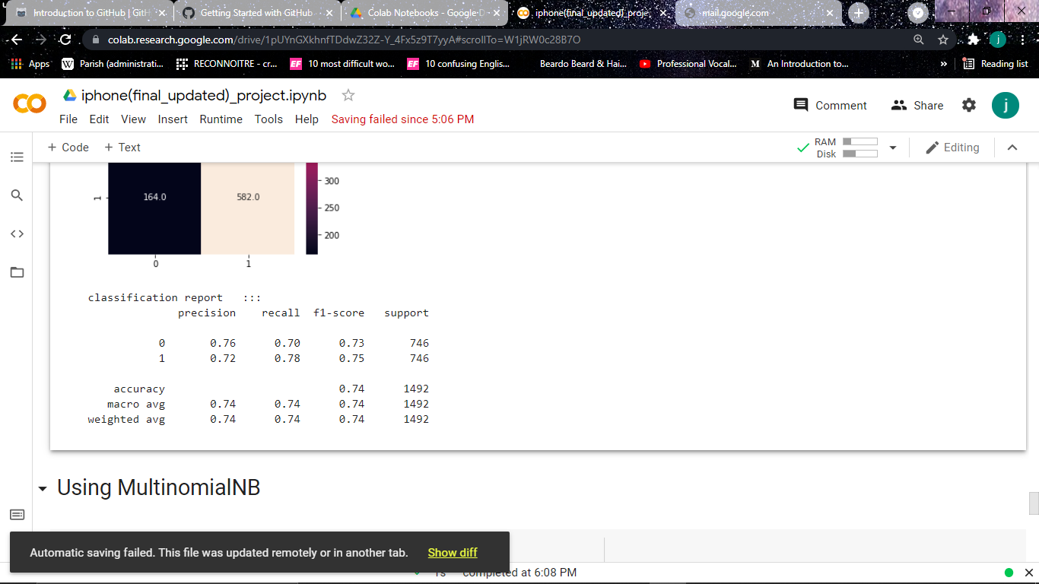
MODEL BUILDING… TF-IDF
LOGISTIC REGRESSION CLASSIFIER

Slide 24
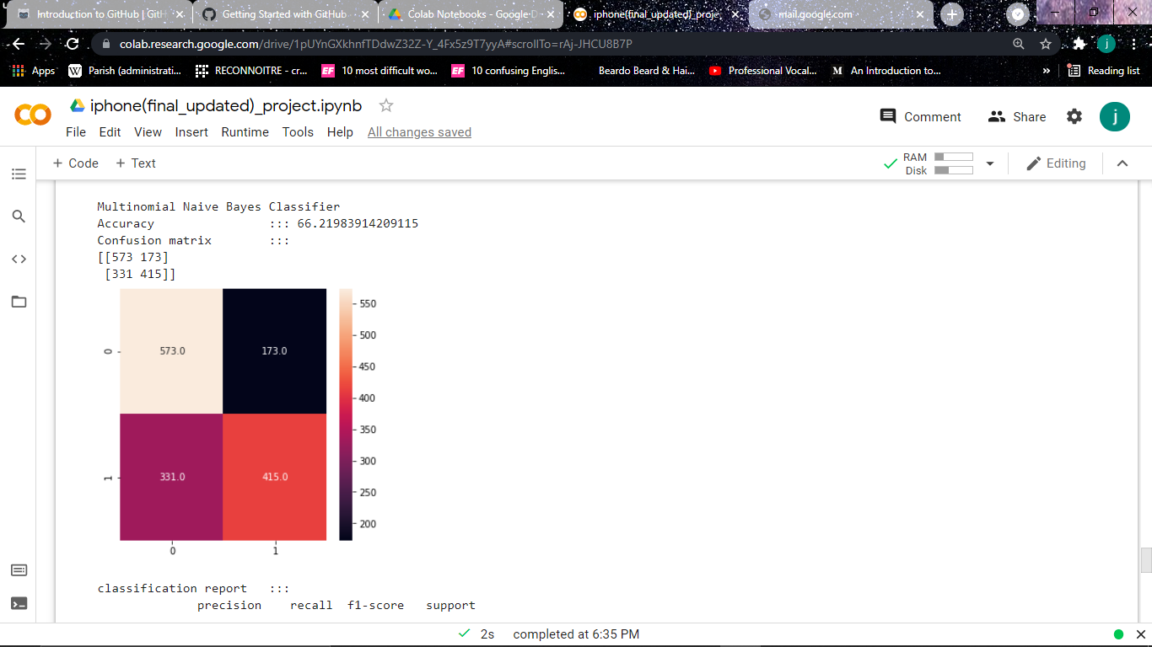
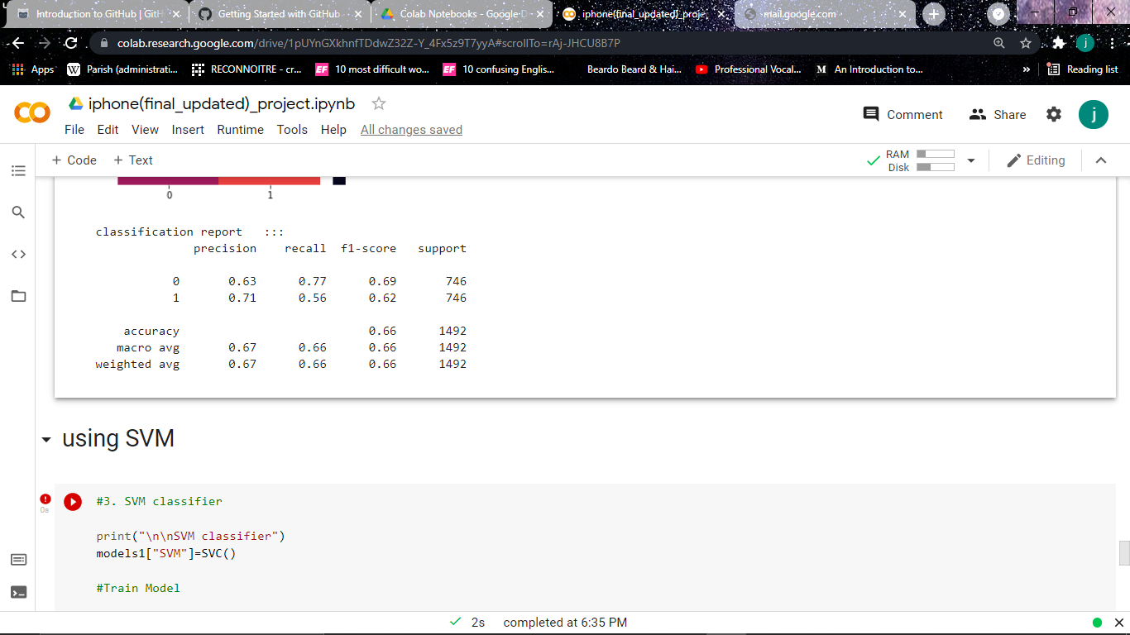
MODEL BUILDING… TF-IDF
MULTINONIAL NAÏVE BAYES

Slide 25
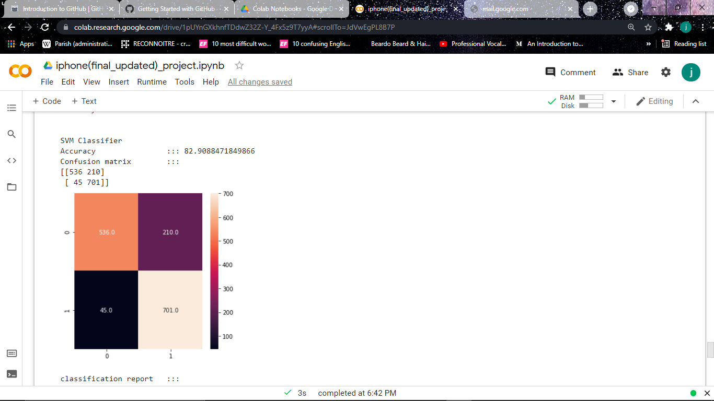
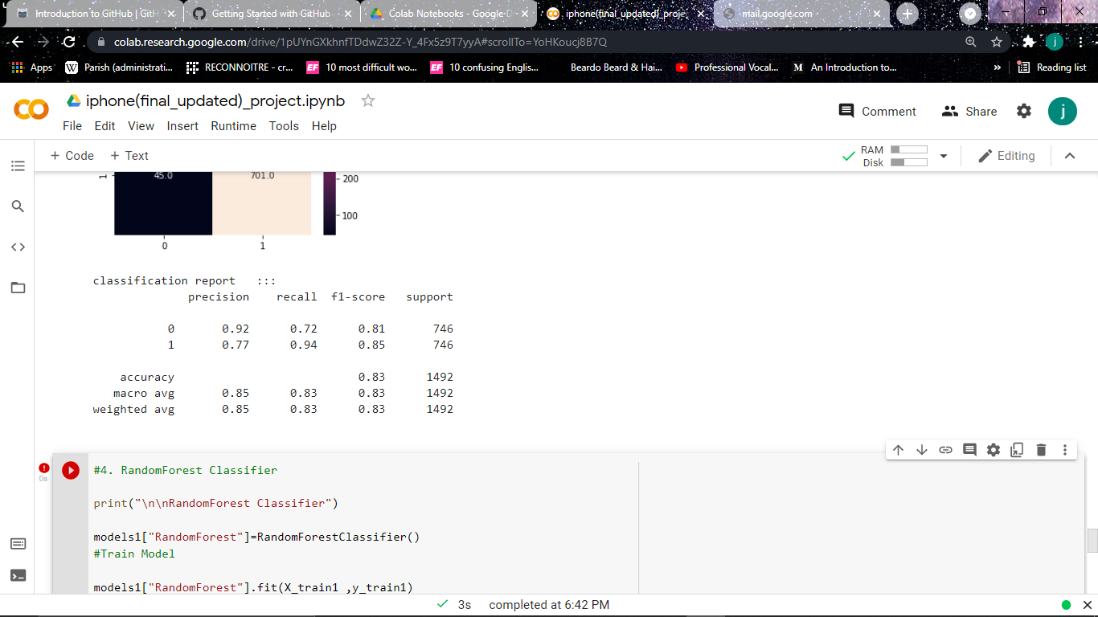
MODEL BUILDING… TF-IDF
SUPPORT VECTORE MACHINE

Slide 26
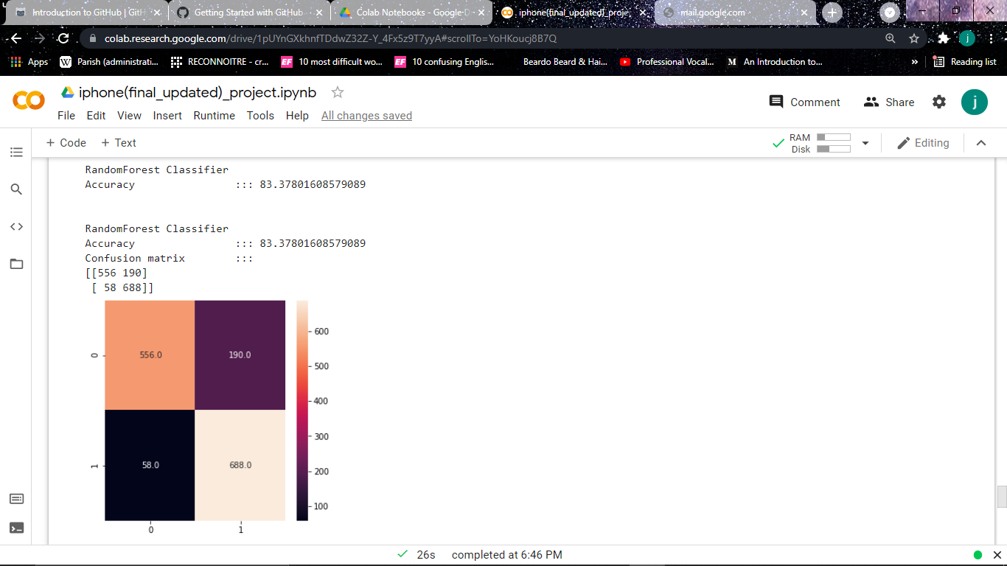
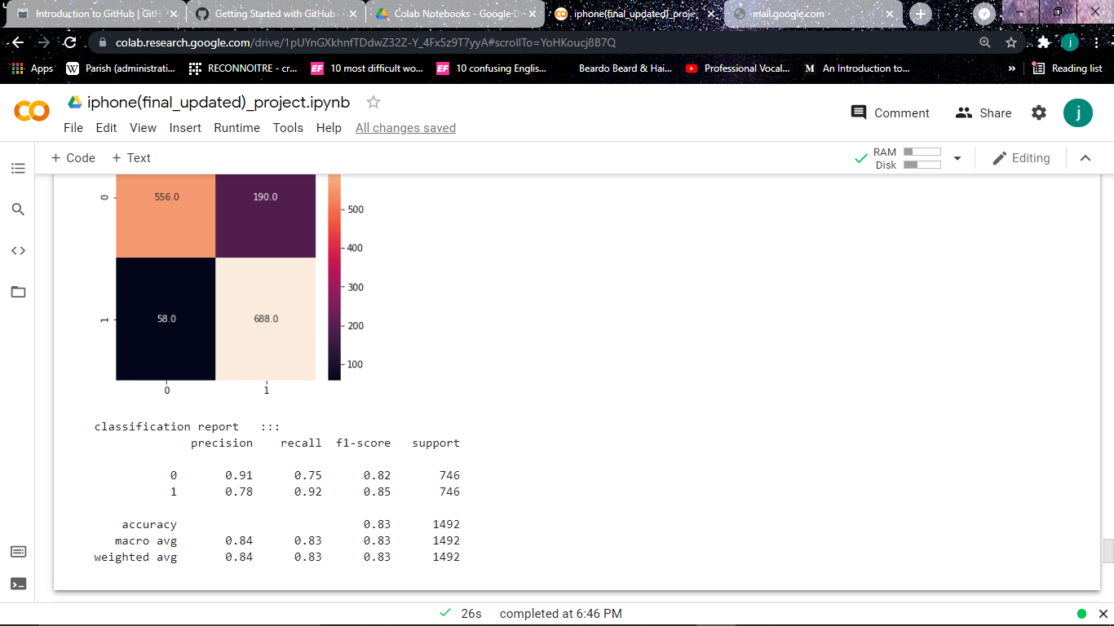
MODEL BUILDING… TF-IDF
RANDOM FOREST CLASSIFIER

Slide 27
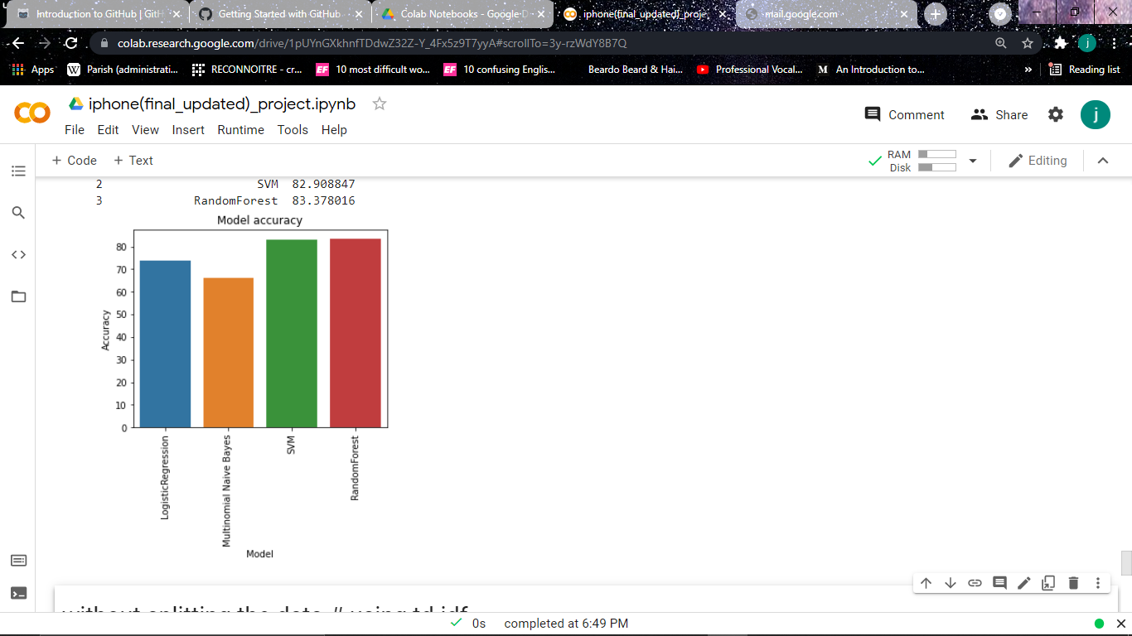
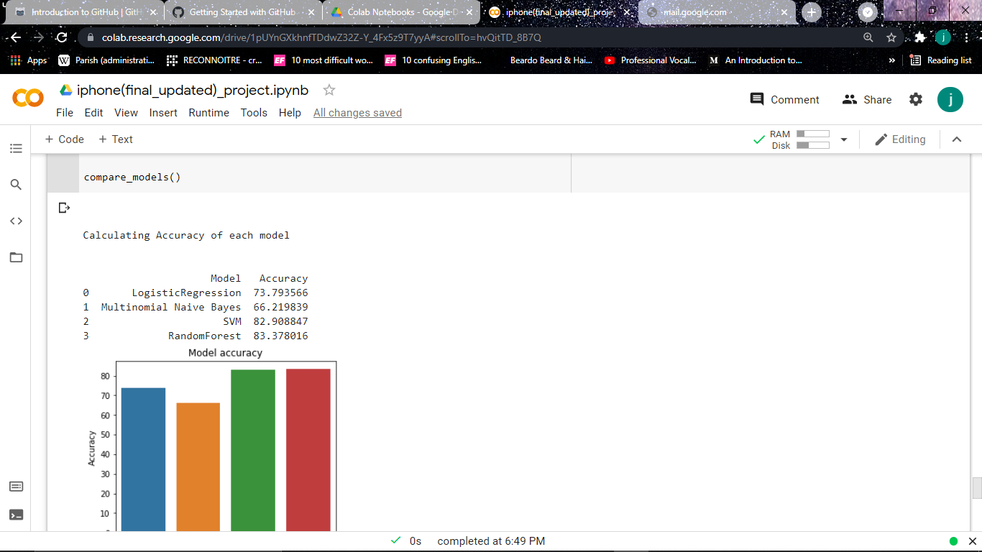
MODEL COMPARISON
V – TF - IDF

Slide 28
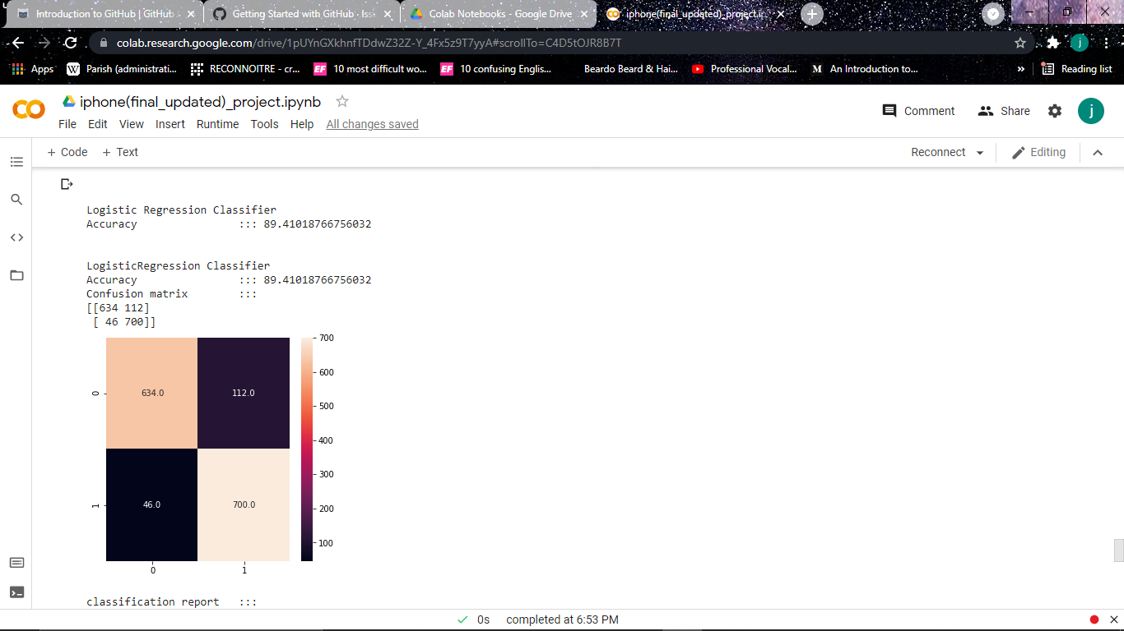
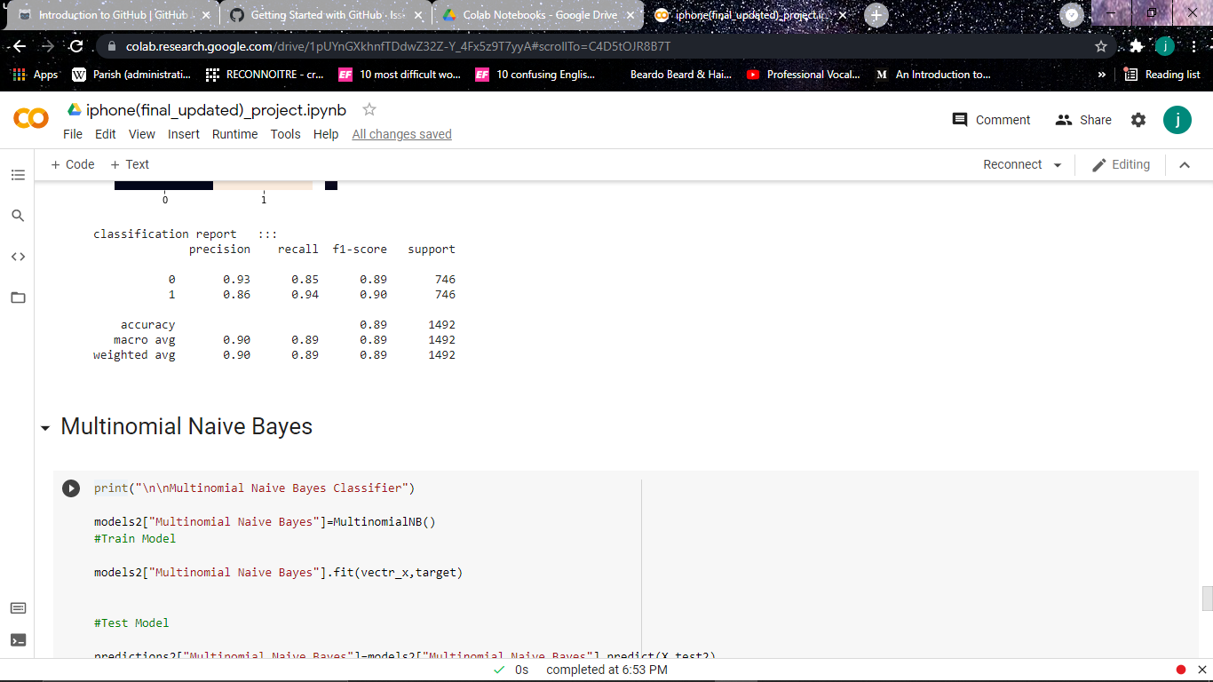
MODEL BUILDING… NO SPLIT
LOGISTIC REGRESSION CLASSIFIER

Slide 29
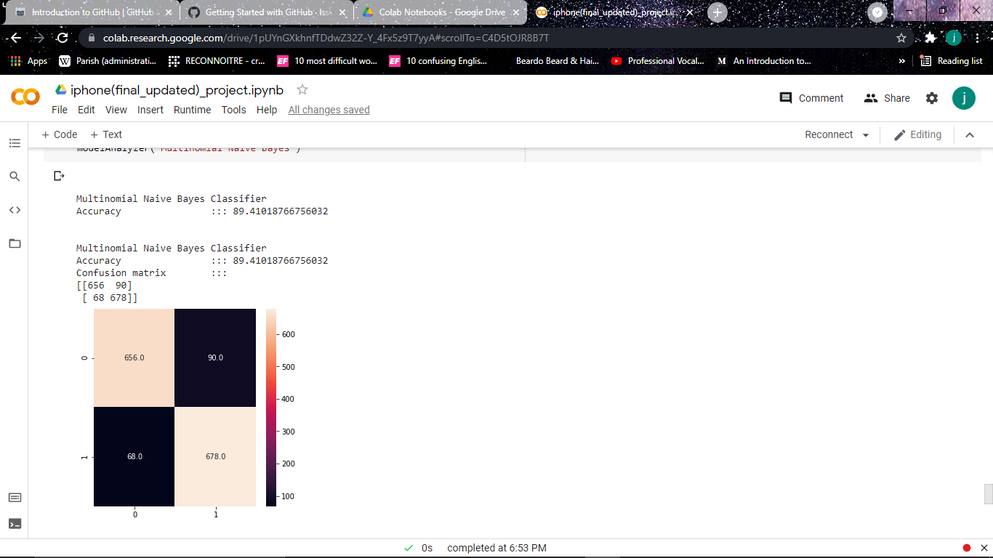
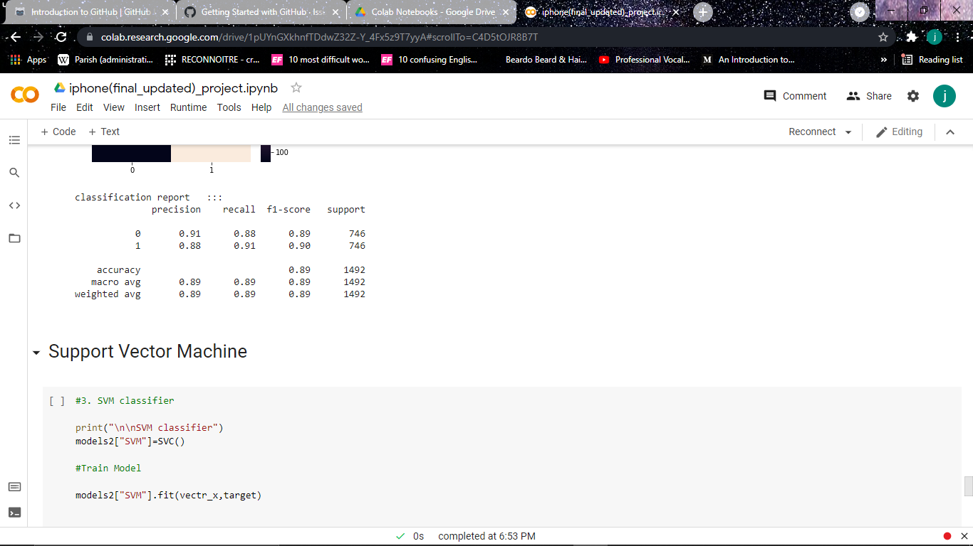
MODEL BUILDING… NO SPLIT
MULTINOMIAL NAÏVE BAYES

Slide 30
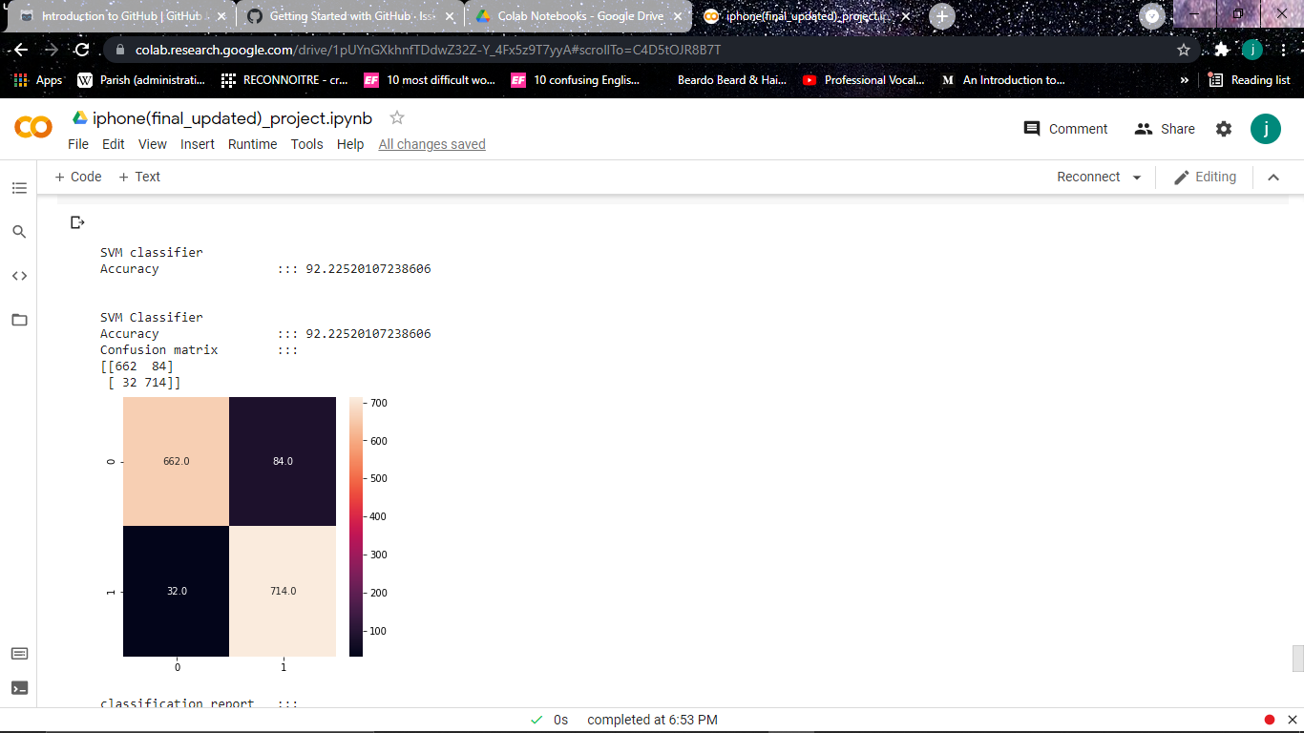
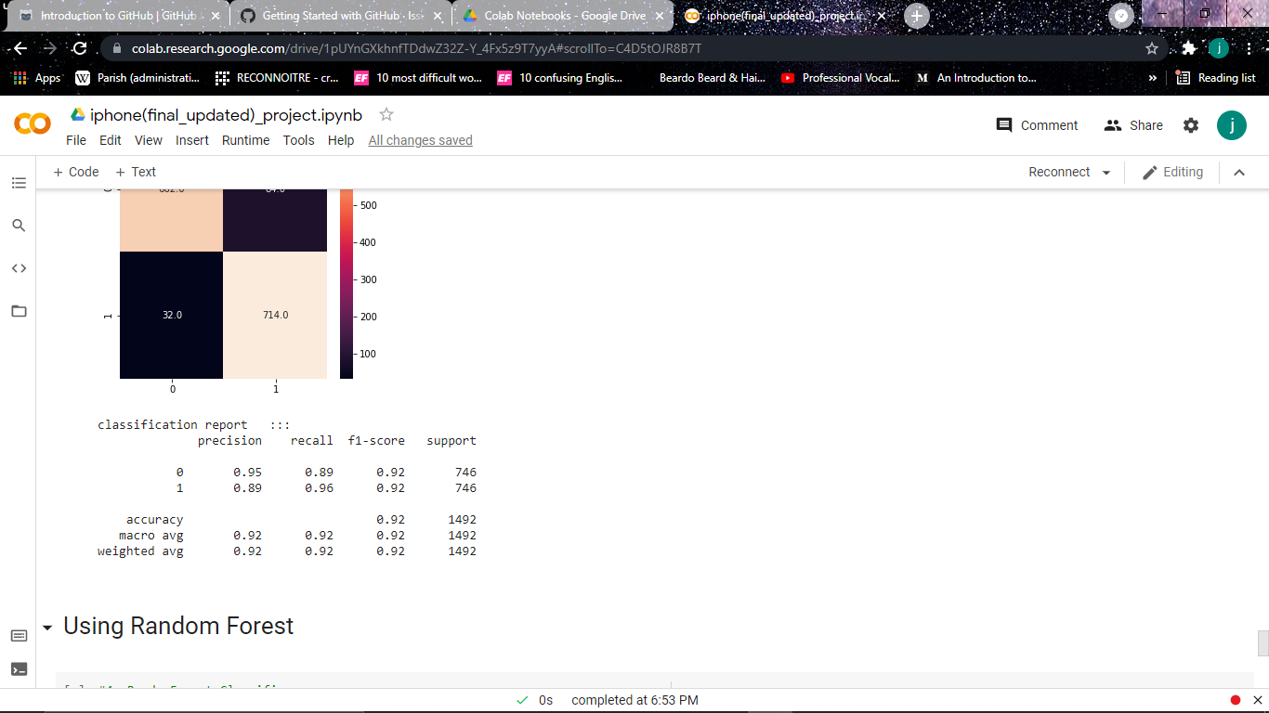
MODEL BUILDING… NO SPLIT
SUPPORT VECTOR MACHINE

Slide 31
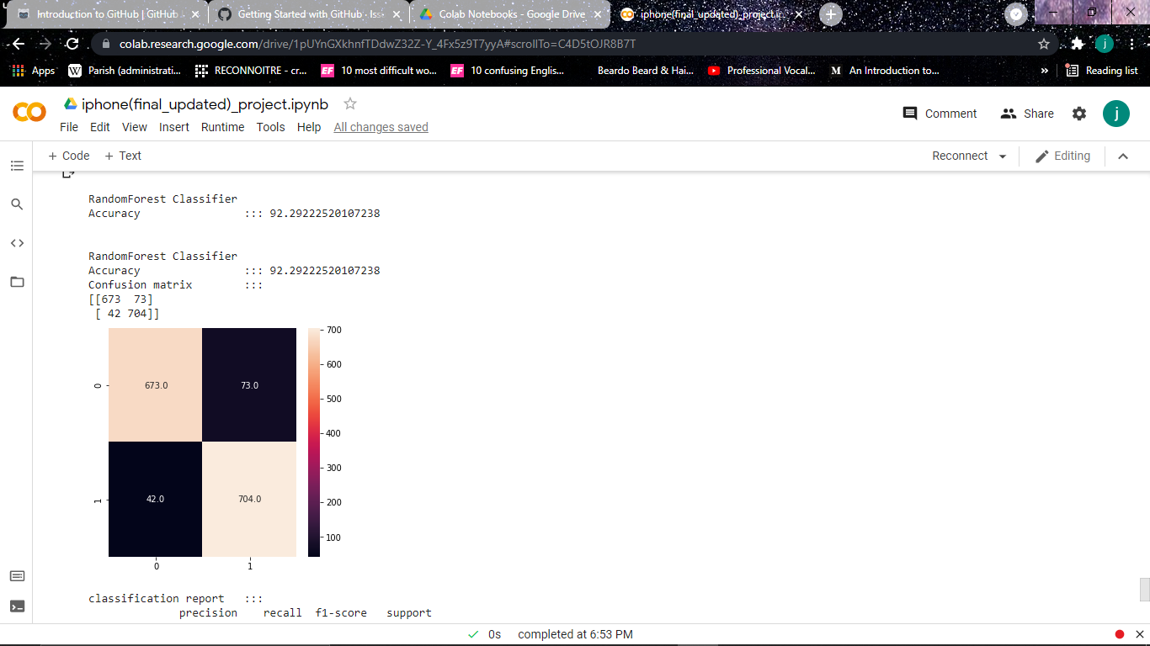
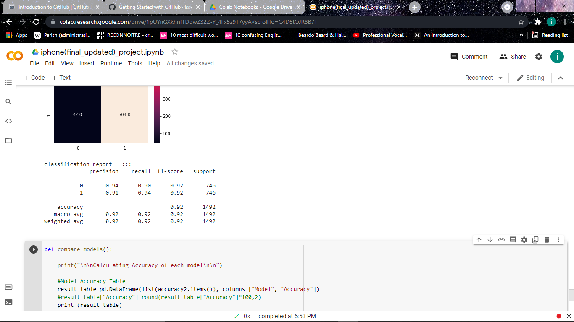
MODEL BUILDING… NO SPLIT
RANDOM FOREST CLASSIFIER

Slide 32
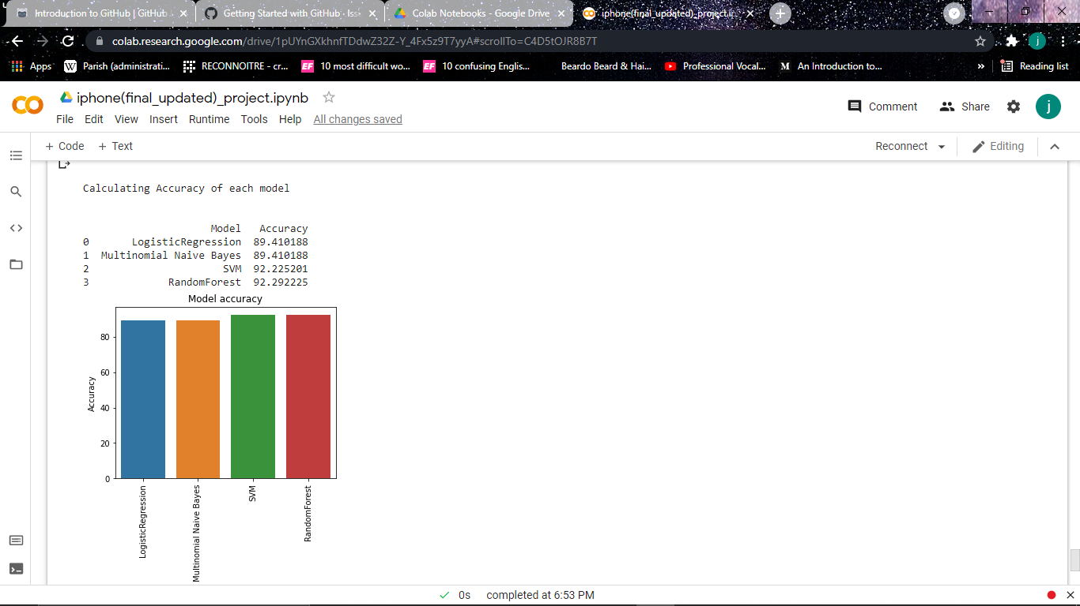
MODEL COMPARISON
NO SPLIT

Slide 33
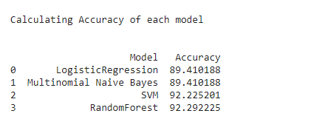
MODEL COMPARISON
TF – IDF
VECTORIZED
COUNTER
VECTORIZED
NO SPLIT

Slide 34
THANK YOU

